Slide 1
UNIT - 1

Slide 2
Architecture
Computer Architecture is concerned with the way hardware components are connected together to form a computer system.
It acts as the interface between hardware and software.
Computer Architecture helps us to understand the functionalities of a system.
A programmer can view architecture in terms of instructions, addressing modes and registers.
Architecture involves Logic (Instruction sets, Addressing modes, Data types, Cache optimization)

Slide 3
Organization
Computer Organization is concerned with the structure and behaviour of a computer system as seen by the user.
It deals with the components of a connection in a system.
Computer Organization tells us how exactly all the units in the system are arranged and interconnected.
Whereas Organization expresses the realization of architecture.
Organization involves Physical Components (Circuit design, Adders, Signals, Peripherals)

Slide 4
Structure & Function
Structure is the way in which components relate to each other.
Function is the operation of individual components as part of the structure.

Slide 5
Function
Both the structure and functioning of a computer are,in essence,simple.Figure 1.1 depicts the basic functions that a computer can perform.In general terms,there are only four:
Data processing.
Data storage
Data movement
Control

Slide 6
Data processing
The computer,of course,must be able to process data.
The data may take a wide variety of forms,and the
range of processing requirements is broad.
Data storage
It is also essential that a computer store data.Even if the
computer is processing data on the fly (i.e., data come
in and get processed, and the results go out immediately) the computer must temporarily store at least those pieces of data that are being worked on at any given moment.

Slide 7
Data movement
The computer must be able to move data between itself
and the outside world. The computer’s operating environ
-ment consists of devices that serve as either sources or
destinations of data.
Control
there must be control of these three functions.Ultimately
this control is exercised by the individual(s) who provides
the computer with instructions.

Slide 8
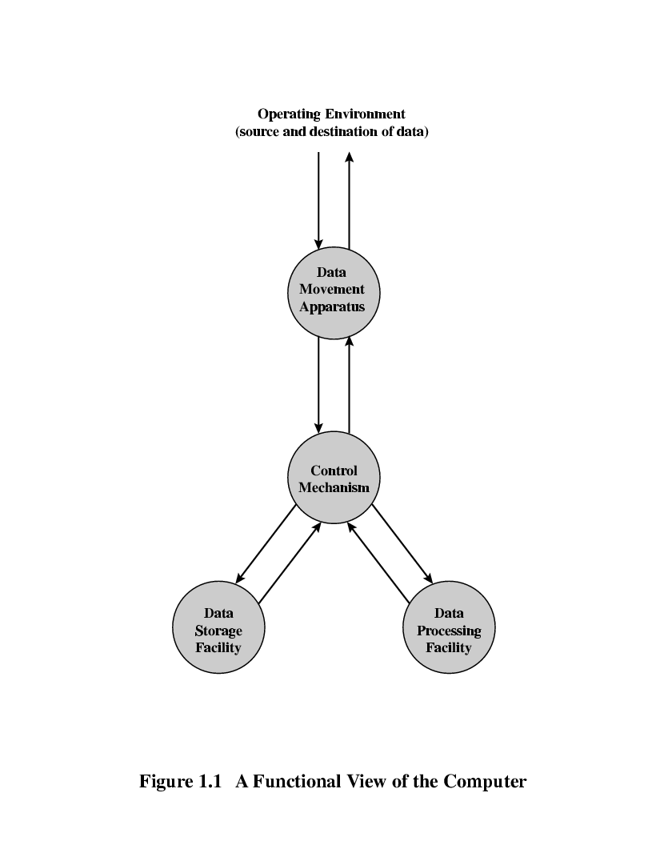
Function View

Slide 9
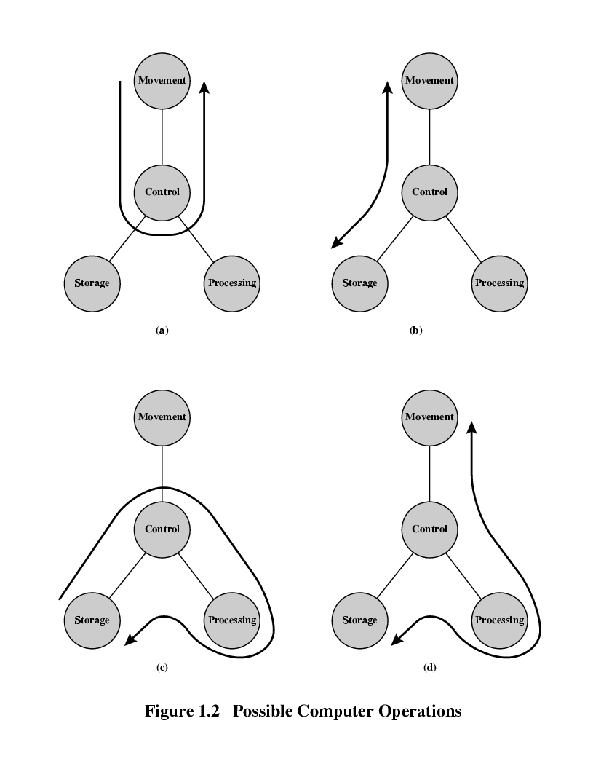
Operations (a) Data movement

Slide 10
Operations (b) Storage

Slide 11
Operation (c) Processing from/to storage

Slide 12
Operation (d) Processing from storage to I/O

Slide 13
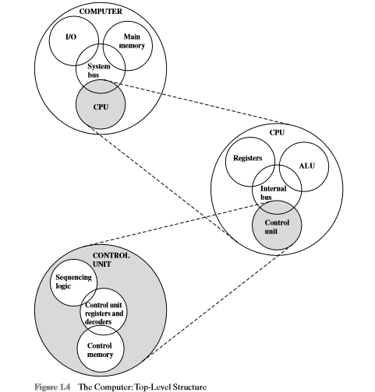
Structure - Top Level

Slide 14
Structure - The CPU
CPU
Computer
Arithmetic
and
Login Unit
I/O
Registers
System
Bus
CPU
Internal CPU
Interconnection
Memory
Control
Unit

Slide 15
Structure - The Control Unit
Control Unit
CPU
ALU
Sequencing
Login
Internal
Bus
Control
Unit
Control Unit
Registers and
Decoders
Registers
Control
Memory

Slide 16
There are four main structural components:
Central processing unit (CPU): Controls the operation of the computer and performs its data processing functions; often simply referred to as processor.
Main memory: Stores data.
I/O: Moves data between the computer and its external environment.
System interconnection: Some mechanism that provides for communication among CPU, main memory, and I/O.

Slide 17
The most complex component is the CPU.Its major structural components are as follows:
Control unit: Controls the operation of the CPU and hence the computer.
Arithmetic and logic unit (ALU): Performs the computer’s data processing functions.
Registers: Provides storage internal to the CPU.
CPU interconnection: Some mechanism that provides for communication among the control unit,ALU,and registers

Slide 18
ENIAC - background
John Mauchly and John Eckert proposed to build a general-purpose computer using vacuum tubes.
In 1943, the Army accepted this proposal.
The ENIAC was completed in 1946, too late to be used in the war effort.
continued to operate under BRL management until 1955,when it was disassembled.

Slide 19
ENIAC - details
weighing 30 tons.
occupying 1500 square feet of floor space.
containing more than 18,000 vacuum tubes.
140 kilowatts of power.
capable of 5000 additions per second.
The ENIAC was a decimal rather than a binary machine.
Its memory consisted of 20 “accumulators”.
capable of holding a 10-digit decimal number.
ring of 10 vacuum tubes represented each digit.

Slide 20
von Neumann/Turing
Stored Program concept
—not setting switches manually from outside
—but storing the instructions and data inside
John von Neumann
—IAS computer
– Started 1946, completed 1952
– Prototype of all subsequent computers
• General structure of IAS computer
—Main memory storing programs and data
—ALU operating on binary data
—Control unit interpreting instructions
—I/O equipment operated by control unit

Slide 21
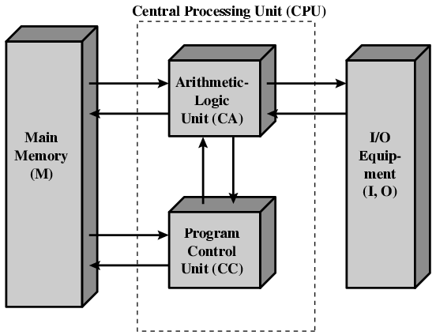
Structure of von Neumann machine

Slide 22
IAS - details
1000 x 40 bit words
Binary number
2 x 20 bit instructions
Set of registers (storage in CPU)
Memory Buffer Register
—Memory Address Register
Instruction Register
Instruction Buffer Register
Program Counter
Accumulator
Multiplier Quotient

Slide 23
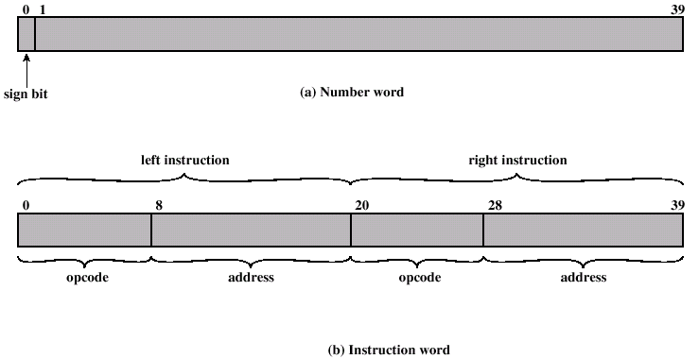
IAS Memory Format

Slide 24
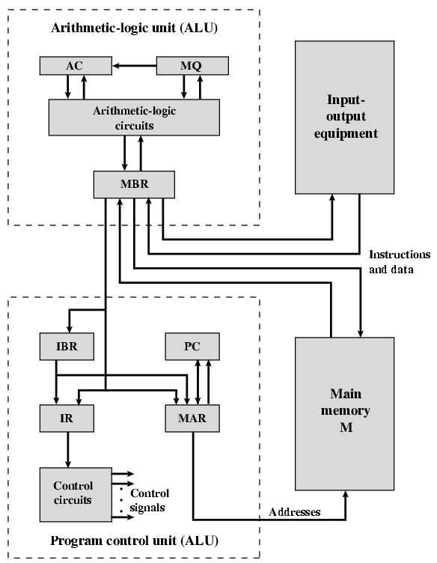
Structure of IAS – detail

Slide 25
IAS - instructions
Total of 21 instructions
Data transfer
Unconditional branch
Conditional branch
Arithmetic
Address modify

Slide 26
Commercial Computers - UNIVAC
1947 - Eckert-Mauchly Computer Corporation
UNIVAC I (Universal Automatic Computer)
US Bureau of Census 1950 calculations
Became part of Sperry-Rand Corporation
Late 1950s - UNIVAC II
Faster, more memory
Upward compatible with the older machines

Slide 27
Commercial Computers - IBM
Punched-card processing equipment
1953 - 701
IBM’s first stored program computer
Scientific calculations
1955 - 702
Business applications
Lead to 7000 series

Slide 28
Transistors
Replaced vacuum tubes
Smaller
Cheaper
Less heat dissipation
Solid State device made from Silicon
Invented 1947 at Bell Labs
William Shockley et al.

Slide 29
Transistor Based Computers
Second generation machines
NCR & RCA produced small transistor machines
IBM followed with 7000 series
DEC - 1957
Produced PDP-1
mini-computer phenomenon began

Slide 30
IBM 7094
• From 700 series to 7094 series
increased performance
increased capacity
lower cost

Slide 31
Microelectronics
What do we need for a digital computer?
they need to perform storage, movement, processing, and control functions
gates and memory cells
Gate
a device that implements a simple logical function
Memory cell
a device that can store one bit of data
Which functions are supported by which device?
Storage : provided by memory cells
Processing : provided by gates
Movement : provided by the interconnection(paths) between components
Control : control signals can be carried by the interconnection

Slide 32
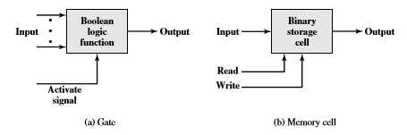
Fundamental Computer Elements
Data storage: Provided by memory cells.
Data processing: Provided by gates.
Data movement: The paths among components are used to move data from memory to memory and from memory through gates to memory.
Control: The paths among components can carry control signals

Slide 33
Computer Generations
Vacuum tube - 1946-1957
Transistor - 1958-1964
Small scale integration - 1965 on
Up to 100 devices on a chip
Medium scale integration - to 1971
100-3,000 devices on a chip
Large scale integration - 1971-1977
3,000 - 100,000 devices on a chip
Very large scale integration - 1978 to date
100,000 - 100,000,000 devices on a chip
Ultra large scale integration
Over 100,000,000 devices on a chip

Slide 34
Moore’s Law
Increased density of components on a chip • Gordon Moore - cofounder of Intel • Number of transistors on a chip will double every year • Since 1970’s development has slowed a little —Number of transistors doubles every 18 months • Consequences of Moore’s law —Cost of a chip has remained almost unchanged —Higher packing density means shorter electrical paths, increasing operating speed —Smaller size, making it more convenient to place in a variety of environments —Reduced power and cooling requirements —Fewer interconnections increases reliability
Growth in CPU Transistor Count

Slide 35
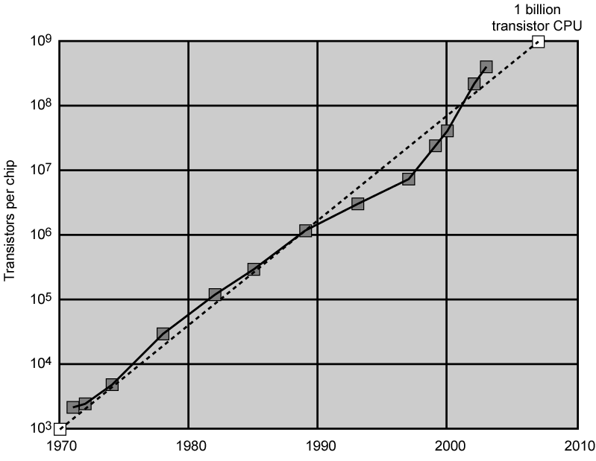
Growth in CPU Transistor Count [BOHR03]

Slide 36
IBM 360 series
1964 • Replaced & not compatible with 7000 series —to produce a system with new IC technology • First planned “family” of computers —Similar or identical instruction sets —Similar or identical O/S —Increasing speed —Increasing number of I/O ports (i.e. more terminals) —Increasing memory size —Increasing cost

Slide 37
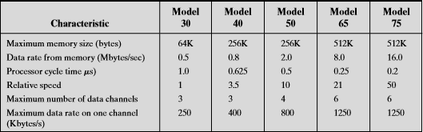
Key Characteristics of the System/360 Family
Similar or identical instruction set: The exact same set of machine instructions is supported on all members of the family.
Similar or identical operating system: The same basic operating system is available for all family members.
Increasing speed: The rate of instruction execution increases in going from lower to higher family members.
Increasing number of I/O ports: The number of I/O ports increases in going from lower to higher family members.
Increasing memory size: The size of main memory increases in going from lower to higher family members.
Increasing cost: At a given point in time,the cost of a system increases in going from lower to higher family members.

Slide 38
DEC PDP-8
1964 • First minicomputer —could not do everything the mainframe could • Small enough to sit on a lab bench • $16,000 —$100k+ for IBM 360 • Use bus structure —Omnibus

Slide 39
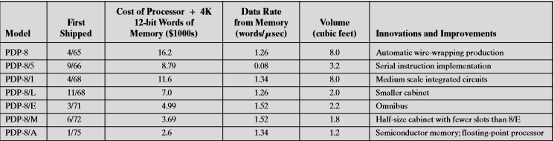
Evolution of the PDP-8 [VOEL88]

Slide 40
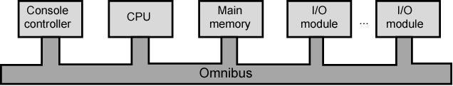
DEC - PDP-8 Bus Structure

Slide 41
Semiconductor Memory
1970 : from core to ICs • Fairchild • Size of a single core could hold 256 bits • Non-destructive read(compared to destructive core) • Much faster than core • Capacity approximately doubles each year —since 1970, 11 generations —1K, 4K, 16K, 64K, 256K, 1M, 4M, 16M, 64M, 256M, 1G
Speeding it up • Besides the number of transistors in a chip…

Slide 42
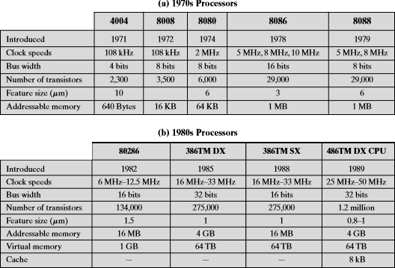
Evolution of Intel Microprocessors

Slide 43
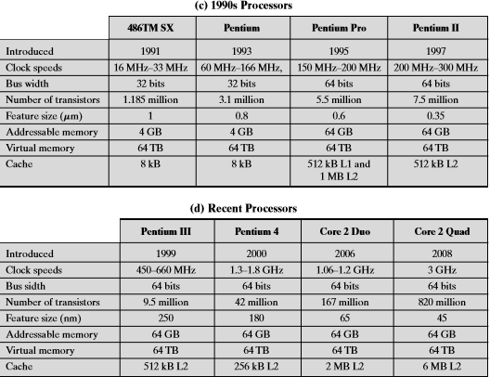
Evolution of Intel Microprocessors

Slide 44
Speeding it up
Besides the number of transistors in a chip… —Pipelining —On board cache – L1 & L2 cache —Branch prediction – if the guess is right most of the time, we can prefetch the correct instructions —Data flow analysis – analyze which instructions are dependent on which – create an optimized schedule of instructions —Speculative execution – speculatively execute instructions ahead of their actual appearance

Slide 45
Performance Balance
Processor speed increased
Memory capacity increased
Memory speed lags behind processor speed

Slide 46
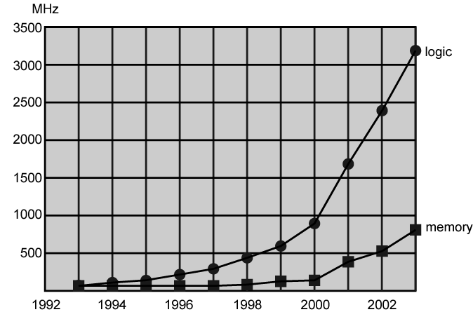
Logic and Memory Performance Gap [BORK03]

Slide 47
Solutions
Increase the number of bits that are retrieved at one time by making DRAMs “wider”rather than “deeper”and by using wide bus data paths.
Change the DRAM interface to make it more efficient by including a cache7.
Reduce the frequency of memory access by incorporating increasingly complex and efficient cache structures between the processor and main memory.
Increase the interconnect bandwidth between processors and memory by using higher-speed buses and by using a hierarchy of buses to buffer and structure data flow.

Slide 48
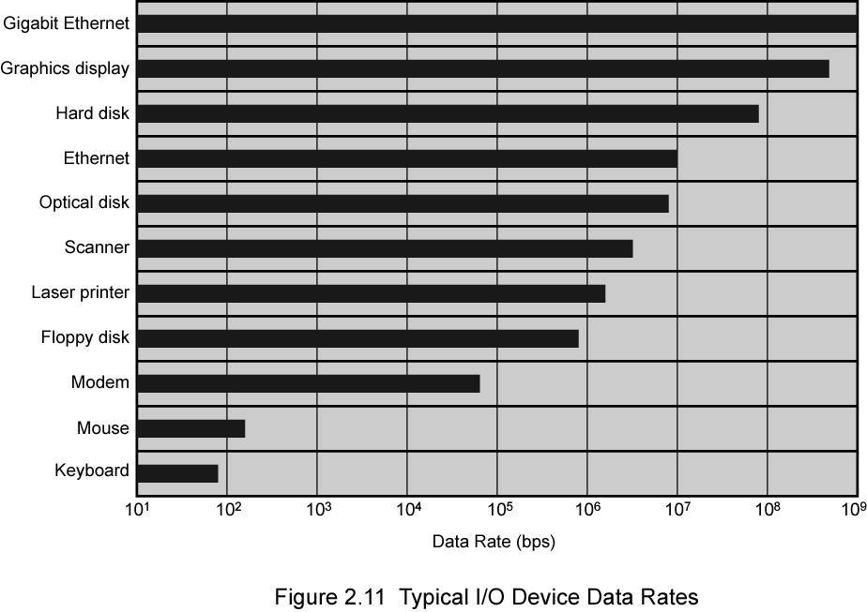
Typical I/O Device Data Rates

Slide 49
Key is Balance
The rate at which performance is changing in the various technology areas (processor, buses, memory, peripherals) differs greatly from one type of element to another.
New applications and new peripheral devices constantly change the nature of the demand on the system in terms of typical instruction profile and the data access patterns.

Slide 50
Improvements in Chip Organization and Architecture
Increase hardware speed of processor
Fundamentally due to shrinking logic gate size
More gates, packed more tightly, increasing clock rate
Propagation time for signals reduced
individual operations are executed more rapidly.
Increase size and speed of caches
Dedicating part of processor chip
Cache access times drop significantly
Change processor organization and architecture
Increase effective speed of execution
Parallelism

Slide 51
Problems with Clock Speed and Login Density
Power: As the density of logic and the clock speed on a chip increase,so does the power density (Watts/cm2).The difficulty of dissipating the heat generated on high-density,high-speed chips is becoming a serious design issue ([GIBB04], [BORK03]).
RC delay: Speed at which electrons flow limited by resistance and capacitance of metal wires connecting them,Delay increases as RC product increases,Wire interconnects thinner, increasing resistance,Wires closer together, increasing capacitance.
Memory latency:Memory speeds lag processor speeds,as previously discussed.

Slide 52
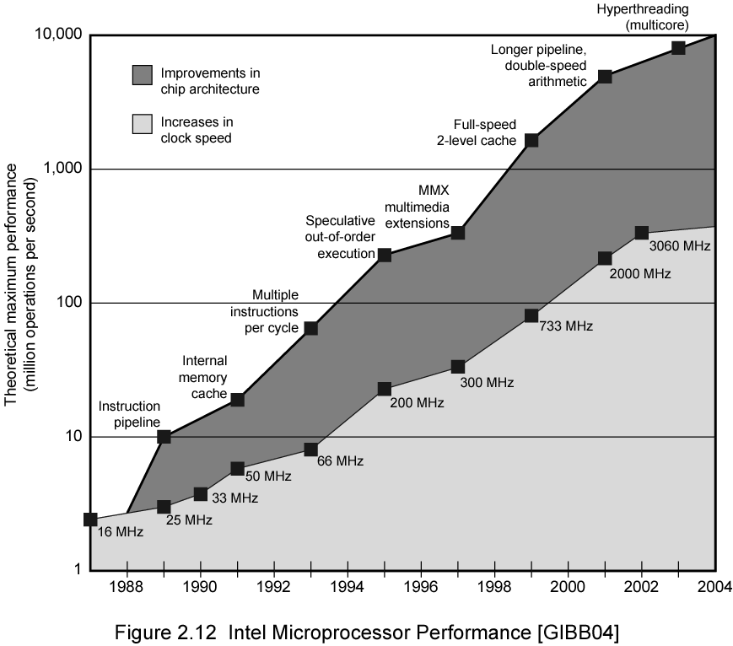
Intel Microprocessor Performance

Slide 53
Increased Cache Capacity
Typically two or three levels of cache between processor and main memory
Chip density increased
More cache memory on chip
Faster cache access
Pentium chip devoted about 10% of chip area to cache
Pentium 4 devotes about 50%

Slide 54
Diminishing Returns
Internal organization of processors complex
Can get a great deal of parallelism
Further significant increases likely to be relatively modest
Benefits from cache are reaching limit
Increasing clock rate runs into power dissipation problem
Some fundamental physical limits are being reached

Slide 55
New Approach – Multiple Cores
Multiple processors on single chip
Large shared cache
Within a processor, increase in performance proportional to square root of increase in complexity
If software can use multiple processors, doubling number of processors almost doubles performance
So, use two simpler processors on the chip rather than one more complex processor
With two processors, larger caches are justified
Power consumption of memory logic less than processing logic

Slide 56
Evolution of the Intel product line(1)
8080: The world’s first general-purpose microprocessor.This was an 8-bit machine, with an 8-bit data path to memory.The 8080 was used in the first personal computer,the Altair.
8086: A far more powerful, 16-bit machine. In addition to a wider data path and larger registers, the 8086 sported an instruction cache, or queue, that prefetches a few instructions before they are executed.
80286: This extension of the 8086 enabled addressing a 16-MByte memory instead of just 1 MByte.
80386: Intel’s first 32-bit machine,and a major overhaul of the product.With a 32-bit architecture, the 80386 rivaled the complexity and power of minicomputers and mainframes introduced just a few years earlier.
80486:The 80486 introduced the use of much more sophisticated and powerful cache technology and sophisticated instruction pipelining.The 80486 also offered a built-in math coprocessor, offloading complex math operations from the main CPU.
Pentium: With the Pentium, Intel introduced the use of superscalar techniques,which allow multiple instructions to execute in parallel.

Slide 57
Evolution of the Intel product line(2)
Pentium Pro: The Pentium Pro continued the move into superscalar organization begun with the Pentium,with aggressive use of register renaming,branch prediction,data flow analysis,and speculative execution.
Pentium II: The Pentium II incorporated Intel MMX technology,which is designed specifically to process video,audio,and graphics data efficiently.
Pentium III: The Pentium III incorporates additional floating-point instructions to support 3D graphics software.
Pentium 4: The Pentium 4 includes additional floating-point and other enhancements for multimedia.
Core: This is the first Intel x86 microprocessor with a dual core, referring to the implementation of two processors on a single chip.
Core 2: The Core 2 extends the architecture to 64 bits.The Core 2 Quad provides four processors on a single chip.

Slide 58
Embedded Systems ARM
Embedded system. A combination of computer hardware and software, and perhaps additional mechanical or other parts, designed to perform a dedicated function.
ARM evolved from RISC design
Used mainly in embedded systems
Used within product
Not general purpose computer
Dedicated function
E.g. Anti-lock brakes in car

Slide 59
Embedded Systems Requirements
Small to large systems, implying very different cost constraints, thus different needs for optimization and reuse.
Relaxed to very strict requirements and combinations of different quality requirements
Short to long life times.
Different environmental conditions in terms of,for example,radiation,vibrations,and humidity.
Different application characteristics resulting in static versus dynamic loads,slow to fast speed, compute versus interface intensive tasks, and/or combinations thereof.
Different models of computation ranging from discrete-event systems to those involving continuous time dynamics.

Slide 60
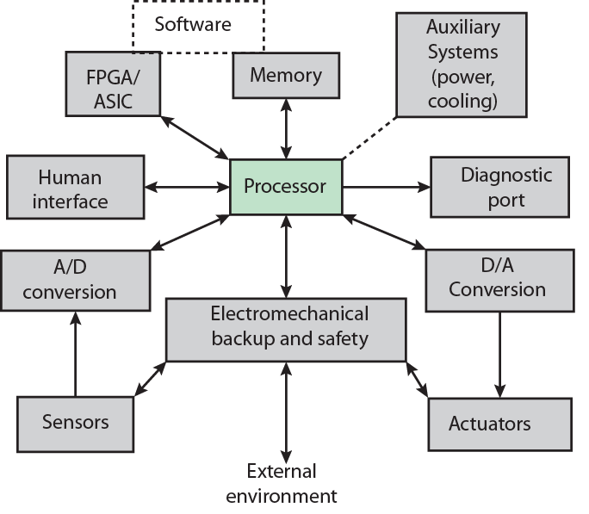
Possible Organization of an Embedded System

Slide 61
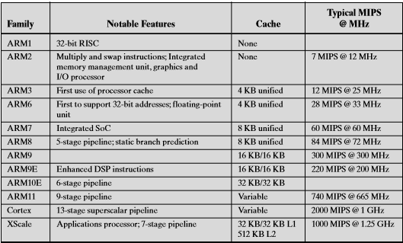
ARM Evolution

Slide 62
ARM Systems Categories
Embedded real-time systems: Systems for storage, automotive body and power-train,industrial,and networking applications
Application platforms: Devices running open operating systems including Linux, Palm OS, Symbian OS, and Windows CE in wireless, consumer entertainment and digital imaging applications
Secure applications: Smart cards,SIM cards,and payment terminals

Slide 63
Performance Assessment Clock Speed
Key parameters
Performance, cost, size, security, reliability, power consumption
System clock speed
In Hz or multiples of
Clock rate, clock cycle, clock tick, cycle time
Signals in CPU take time to settle down to 1 or 0
Signals may change at different speeds
Operations need to be synchronised
Instruction execution in discrete steps
Fetch, decode, load and store, arithmetic or logical
Usually require multiple clock cycles per instruction
Pipelining gives simultaneous execution of instructions
So, clock speed is not the whole story

Slide 64
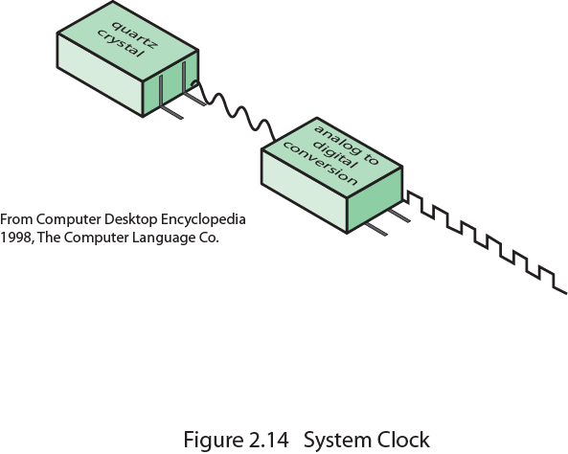
System Clock

Slide 65
Instruction Execution Rate
Millions of instructions per second (MIPS)
Millions of floating point instructions per second (MFLOPS)
Heavily dependent on instruction set, compiler design, processor implementation, cache & memory hierarchy

Slide 66
Benchmarks
Programs designed to test performance
Written in high level language
Portable
Represents style of task
Systems, numerical, commercial
Easily measured
Widely distributed
E.g. System Performance Evaluation Corporation (SPEC)
CPU2006 for computation bound
17 floating point programs in C, C++, Fortran
12 integer programs in C, C++
3 million lines of code
Speed and rate metrics
Single task and throughput

Slide 67

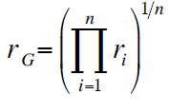
SPEC Speed Metric
Single task
Base runtime defined for each benchmark using reference machine
Results are reported as ratio of reference time to system run time
Tref_{i} execution time for benchmark i on reference machine
Tsut_{i} execution time of benchmark i on test system
Overall performance calculated by averaging ratios for all 12 integer benchmarks
Use geometric mean
Appropriate for normalized numbers such as ratios

Slide 68
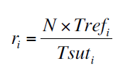
SPEC Rate Metric
Measures throughput or rate of a machine carrying out a number of tasks
Multiple copies of benchmarks run simultaneously
Typically, same as number of processors
Ratio is calculated as follows:
Tref_{i} reference execution time for benchmark i
N number of copies run simultaneously
Tsuti elapsed time from start of execution of program on all N processors until completion of all copies of program
Again, a geometric mean is calculated

Slide 69
Amdahl’s Law
Gene Amdahl [AMDA67]
Potential speed up of program using multiple processors
Concluded that:
Code needs to be parallelizable
Speed up is bound, giving diminishing returns for more processors
Task dependent
Servers gain by maintaining multiple connections on multiple processors
Databases can be split into parallel tasks

Slide 70
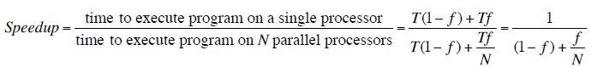
Amdahl’s Law Formula
For program running on single processor
Fraction f of code infinitely parallelizable with no scheduling overhead
Fraction (1-f) of code inherently serial
T is total execution time for program on single processor
N is number of processors that fully exploit parralle portions of code
Conclusions
f small, parallel processors has little effect
N ->∞, speedup bound by 1/(1 – f)
Diminishing returns for using more processors

Slide 71
UNIT-2

Slide 72
Input output organization:
The input-output subsystem of a computer provides an efficient mode of communication between the central system and the outside environment. It handles all the input-output operations of the computer system.
PERIPHERALS:- Input or output devices that are connected to computer are called peripheral devices. These devices are designed to read information into or out of the memory unit upon command from the CPU and are considered to be the part of computer system. These devices are also called peripherals

Slide 73
There are three type of Peripheral-
Input Peripherals- An input device is a peripheral(piece of computer hardware equipment) used to provide data and control signals to an information processing system such as a computer or other information appliance.
Output Peripherals-An output device is any peripheral that receives data from a computer, usually for display, projection, or physical reproduction.
Input-output Peripherals- The I/O (input and output) peripheral are used primarily for communication between the computer and the external environment. They provide the ability to enter commands to the PC, and vice versa, i.e. send commands to outside to perform some task on a given device.

Slide 74
Working Of Peripherals
An input device converts incoming data and instructions into a pattern of electrical signals in binary code that are comprehensible to a digital computer. An output device reverses the process, translating the digitized signals into a form intelligible to the user.
Input peripherals : Allows user input, from the outside world to the computer. Example: Keyboard, Mouse etc.
Output peripherals: Allows information output, from the computer to the outside world. Example: Printer, Monitor etc.
Input-Output peripherals: Allows both input(from outside world to computer) as well as, output(from computer to the outside world). Example: Touch screen etc.

Slide 75
Interrupt Driven I/O
Interrupt driven I/O is an alternative scheme dealing with I/O. Interrupt I/O is a way of controlling input/output activity whereby a peripheral or terminal that needs to make or receive a data transfer sends a signal.
This will cause a program interrupt to be set. At a time appropriate to the priority level of the I/O interrupt. Relative to the total interrupt system, the processors enter an interrupt service routine.
The function of the routine will depend upon the system of interrupt levels and priorities that is implemented in the processor.
The interrupt technique requires more complex hardware and software, but makes far more efficient use of the computer’s time and capacities. Figure 2 shows the simple interrupt processing.

Slide 76
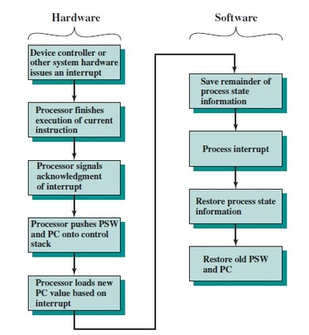

Slide 77
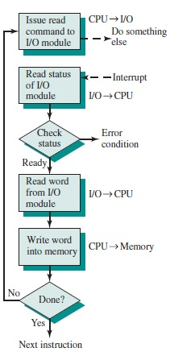
Interrupt Processing

Slide 78
PRIORITY INTERRUPT
Priority Interrupt are systems, that establishes a Priority over the various sources(interrupt devices) to determine which condition is to be serviced first when two or more requests arrive simultaneously .
This system may also determine which condition are permitted to interrupt to the computer while another interrupt is being serviced .
Usually, in Priority Systems, higher-priority interrupt levels are served first, as if they delayed or interrupted, could have serious consequences . And the devices with high-speed transfer such as magnetic disks are given high-priority, and slow devices such as keyboards receives low-priority.

Slide 79
Direct Memory Access
DMA stands for "Direct Memory Access" and is a method of transferring data from the computer's RAM to another part of the computer without processing it using the CPU.
While most data that is input or output from your computer is processed by the CPU, some data does not require processing, or can be processed by another device.
In these situations, DMA can save processing time and is a more efficient way to move data from the computer's memory to other devices.
In order for devices to use direct memory access, they must be assigned to a DMA channel. Each type of port on a computer has a set of DMA channels that can be assigned to each connected device. For example, a PCI controller and a hard drive controller each have their own set of DMA channels.

Slide 80
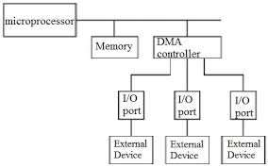

Slide 81
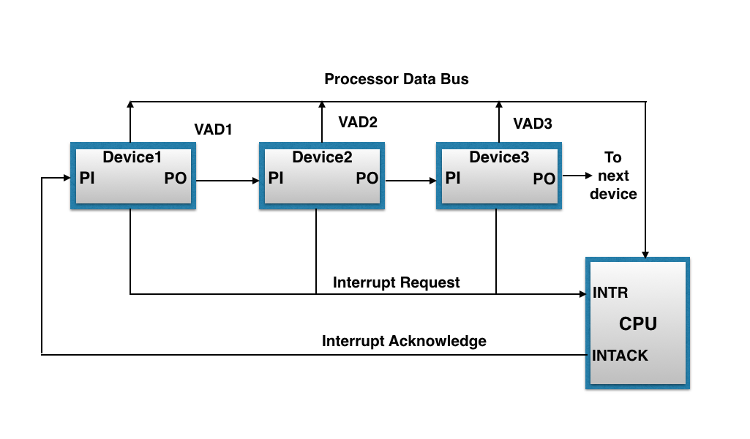
The figure shown below, this method of connection with three devices and the CPU.

Slide 82
It works as follows:
When any device raise an interrupt, the interrupt request line goes activated, the processor when sense it, it sends out an interrupt acknowledge which is first received by device1.If device1 does not need service, i.e., processor checks, whether the device has pending interrupt or initiate interrupt request, if the result is no, then the signal is passed to device2 by placing 1 in the PO(Priority Out) of device1.And if device need service then service is given to them by placing first 0 in the PO of 1 device1, which indicate the next-lower-priority device that acknowledge signal has been blocked.And device that have processor responds by inserting its own interrupt vector address(VAD) into the data bus for the CPU to use during interrupt cycle.
In this way, it gave services to interrupt source according to their priority.And thus, we can say that, it is the order of device in chain that determine the priority of interrupt sources.

Slide 83
DMA
Stands for "Direct Memory Access." DMA is a method of transferring data from the computer's RAM to another part of the computer without processing it using the CPU. While most data that is input or output from your computer is processed by the CPU, some data does not require processing, or can be processed by another device. In these situations, DMA can save processing time and is a more efficient way to move data from the computer's memory to other devices.
For example, a sound card may need to access data stored in the computer's RAM, but since it can process the data itself, it may use DMA to bypass the CPU. Video cards that support DMA can also access the system memory and process graphics without needing the CPU. Ultra DMA hard drives use DMA to transfer data faster than previous hard drives that required the data to first be run through the CPU.

Slide 84
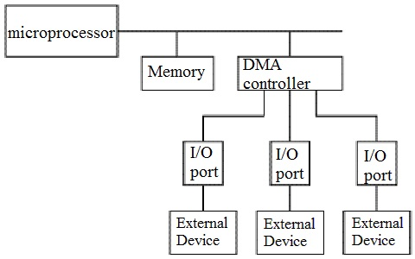

Slide 85
I/O Processor and serial communication
An input-output processor (IOP) is a processor with direct memory access capability. In this, the computer system is divided into a memory unit and number of processors.
Each IOP controls and manage the input-output tasks. The IOP is similar to CPU except that it handles only the details of I/O processing. The IOP can fetch and execute its own instructions. These IOP instructions are designed to manage I/O transfers only.

Slide 86
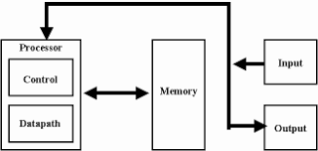
Block Diagram Of I/O Processor

Slide 87
Synchronous Data Transfer
In Synchronous data transfer, the sending and receiving units are enabled with same clock signal. It is possible between two units when each of them knows the behavior of the other.
The master performs a sequence of instructions for data transfer in a predefined order. All these actions are synchronized with the common clock.
The master is designed to supply the data at a time when the slave is definitely ready for it. Usually, the master will introduce sufficient delay to take into account the slow response of the slave, without any request from the slave.

Slide 88
Asynchronous Data Transfer
In most computer asynchronous mode of data transfer is used in which two component have a different clock. Data transfer can occur between data in two ways serial and parallel.
In case of parallel multiple lines are used to send a single bit whereas in serial transfer each bit is send one at a time. To tell other devices when the character/data will be given a concept of start and end bit is used.
A start bit is denoted by 0 and stop bit is detected when line return to 1-state at least one time, here 1-state means that there is not data transfer is occurring.

Slide 89
Strobe Control
In computer or memory technology, a strobe is a signal that is sent that validates data or other signals on adjacent parallel lines.
In memory technology, the CAS (column address strobe) and RAS ( row address strobe ) signals are used to tell a dynamic RAM that an address is a column or row address.

Slide 90
Strobe Mechanism
Source initiated Strobe – When source initiates the process of data transfer. Strobe is just a signal. Step are-
First, source puts data on the data bus and ON the strobe signal.
Destination on seeing the ON signal of strobe, read data from the data bus.
After reading data from the data bus by destination, strobe gets OFF

Slide 91
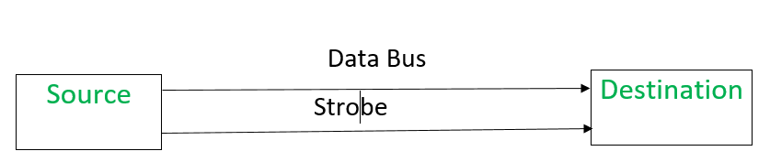
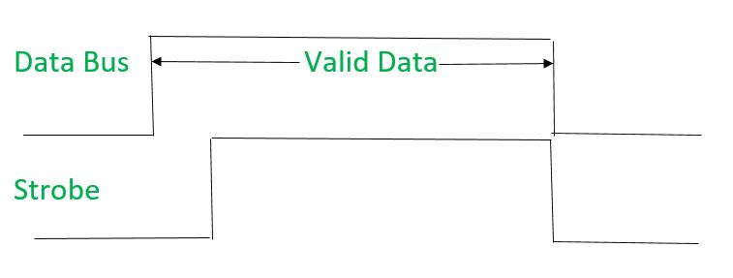

Slide 92
Destination initiated signal
When destination initiates the process of data transfer. Steps are-
First, the destination ON the strobe signal to ensure the source to put the fresh data on the data bus.
Source on seeing the ON signal puts fresh data on the data bus.
Destination reads the data from the data bus and strobe gets OFF signal.

Slide 93
Working principle of keyboard
Working Principle of a Keyboard:-Inside the keyboard, there are metallic plate, circuit board and processor, which are responsible for transferring information from the keyboard to the computer. Depending upon the working principle, there are two main types of keys, namely, capacitive and hard-contact. Let's discuss in brief about the functioning of capacitive and hard contact key . When a capacitive key is pressed, the metal plunger applies a gentle pressure to the circuit board. The pressure is identified by the computer and the circuit flow is initiated, resulting in the transfer of information from the circuit to the currently installed software. The key identifying to computer is identified using a keyboard driver and finding the preferred key called source code.

Slide 94
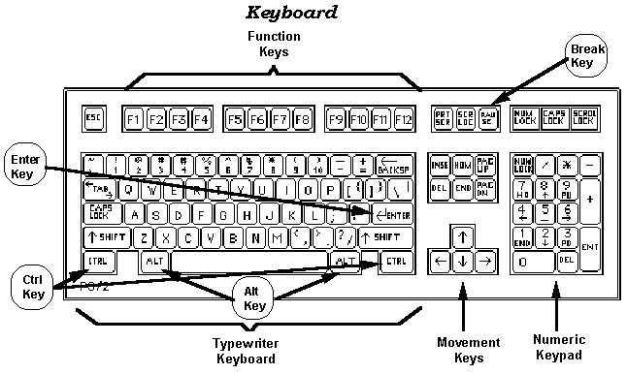

Slide 95
Working Mechanism Of Mouse
The main goal of any mouse is to translate the motion of your hand into signals that the computer can use. Let's take a look inside a track-ball mouse to see how it works:
A ball inside the mouse touches the desktop and rolls when the mouse moves. The underside of the mouse's logic board: The exposed portion of the ball touches the desktop.

Slide 96
Two rollers inside the mouse touch the ball. One of the rollers is oriented so that it detects motion in the X direction, and the other is oriented 90 degrees to the first roller so it detects motion in the Y direction. When the ball rotates, one or both of these rollers rotate as well. The following image shows the two white rollers on this mouse: The rollers that touch the ball and detect X and Y motion.
The rollers each connect to a shaft, and the shaft spins a disk with holes in it. When a roller rolls, its shaft and disk spin. \
On either side of the disk there is an infrared LED and an infrared sensor. The holes in the disk break the beam of light coming from the LED so that the infrared sensor sees pulses of light. The rate of the pulsing is directly related to the speed of the mouse and the distance it travels. A close-up of one of the optical encoders that track mouse motion: There is an infrared LED (clear) on one side of the disk and an infrared sensor (red) on the other.
An on-board processor chip reads the pulses from the infrared sensors and turns them into binary data that the computer can understand. The chip sends the binary data to the computer through the mouse's cord.

Slide 97
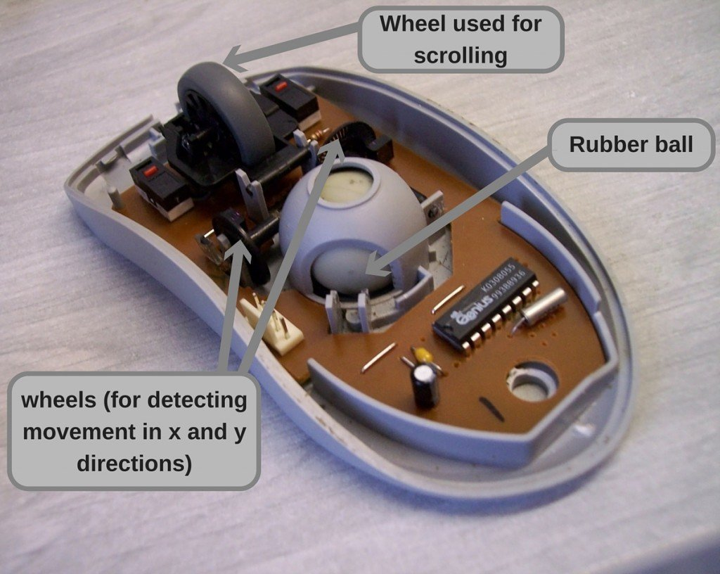

Slide 98
Working Mechanism Of Scanner
Scanners operate by shining light at the object or document being digitized and directing the reflected light (usually through a series of mirrors and lenses) onto a photosensitive element. In most scanners, the sensing medium is an electronic, light-sensing integrated circuit known as a charged coupled device (CCD). Light-sensitive photosites arrayed along the CCD convert levels of brightness into electronic signals that are then processed into a digital image.

Slide 99
CCD is by far the most common light-sensing technology used in modern scanners. Two other technologies, CIS (Contact Image Sensor), and PMT (photomultiplier tube) are found in the low and high ends of the scanner market, respectively. CIS is a newer technology that allows scanners to be smaller and lighter, but sacrifices dynamic range, depth-of-field, and resolution. PMT-based drum scanners produce very high-quality images.
Another sensing technology, CMOS (Complementary Metal Oxide Semiconductor), appears primarily in low-end, hand-held digital cameras where its low cost, low power consumption and easier component integration permits smaller, less expensive designs. Traditionally, high-end and professional digital cameras employ CCD sensors, despite their expense and the complexity of their design, because they exhibit much superior noise characteristics. Although some innovative designs that render low-noise CMOS-based images are emerging, CCD still dominates the high end of the market.

Slide 100
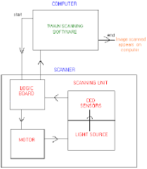

Slide 101
UNIT-3

Slide 102
CONTROL UNIT

Slide 103
Instruction Word Format
Instruction format An instruction is normally made up of a combination of an operation code and some way of specifying an operand, most commonly by its location or address in memory though non memory reference instructions can exist. Some operation codes deal with more than one operand; the locations of these operands may be specified using any of the many addressing schemes . Classically, the number of address references has been used to specify something about the architecture of a particular computer. In some instruction formats and machine architectures, the number of operand references may be fixed; in others the number is variable.

Slide 104
Fetch Cycle
The fetch execute cycle is the basic operation (instruction) cycle of a computer (also known as the fetch decode execute cycle).
During the fetch execute cycle, the computer retrieves a program instruction from its memory. It then establishes and carries out the actions that are required for that instruction.
At the beginning of the fetch cycle, the address of the next instruction to be executed is in the Program Counter(PC).

Slide 105
Step 1: The address in the program counter is moved to the memory address register(MAR), as this is the only register which is connected to address lines of the system bus.
Step 2: The address in MAR is placed on the address bus, now the control unit issues a READ command on the control bus, and the result appears on the data bus and is then copied into the memory buffer register(MBR). Program counter is incremented by one, to get ready for the next instruction.(These two action can be performed simultaneously to save time).
Step 3: The content of the MBR is moved to the instruction register(IR).

Slide 106
Execution Cycle
It is the part of the cycle when data processing actually take place and the instruction is called upon data & The result of this processing is stored in another register this is called Execution cycle. The other three cycles(Fetch, Indirect and Interrupt) are simple and predictable. Each of them requires simple, small and fixed sequence of micro-operation. In each case same micro-operation are repeated each time around. Execute Cycle is different from them. Like, for a machine with N different opcodes there are N different sequence of micro-operations that can occur .

Slide 107
Microprogramming Concepts
Process of writing microcode for a microprocessor. Microcode is low-level code that defines how a microprocessor should function when it executes machine-language instructions. Typically, one machine-language instruction translates into several microcode instructions. On some computers, the microcode is stored in ROM and cannot be modified; on some larger computers, it is stored in EPROM and therefore can be replaced with newer versions.

Slide 108
ADDRESSING MODES
The operation field of an instruction specifies the operation to be performed. This operation must
be executed on some data stored in computer registers or memory words. The way the operands
are chosen during program execution in dependent on the addressing mode of the instruction.

Slide 109
To understand the various addressing modes to be presented in this section, it is imperative that we understand the basic operation cycle of the computer. The control unit of a computer is designed to go through an instruction cycle that is divided into three major phases:
1. Fetch the instruction from memory
2. Decode the instruction.
3. Execute the instruction.

Slide 110
Direct Address Mode: In this mode the effective address is equal to the address part of the instruction. The operand resides in memory and its address is given directly by the address field of the instruction. In a branch-type instruction the address field specifies the actual branch address.
Indirect Address Mode: In this mode the address field of the instruction gives the address where the effective address is stored in memory. Control fetches the instruction from memory and uses its address part to access memory again to read the effective address.

Slide 111
Indexed Addressing Mode:
In this mode the content of an index register is added to the address part of the instruction to obtain the effective address. The index register is a special CPU register that contains an index value. The address field of the instruction defines the beginning address of a data array in memory. Each operand in the array is stored in memory relative to the beginning address. The distance between the beginning address and the address of the operand is the index value stores in the index register. Any operand in the array can be accessed with the same instruction provided that the index register contains the correct index value. The index register can be incremented to facilitate access to consecutive operands.

Slide 112
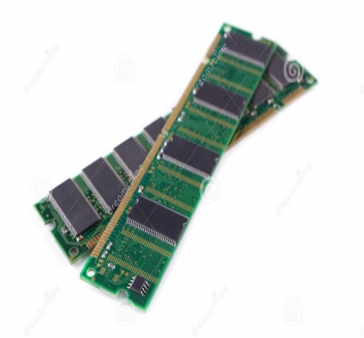
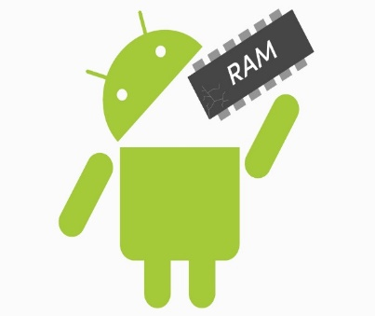
UNIT - 4

Slide 113
MEMORY HIERARCHY
The memory hierarchy design in a computer system mainly includes different storage devices. Most of the computers were inbuilt with extra storage to run more powerfully beyond the main memory capacity. The following memory hierarchy diagram is a hierarchical pyramid for computer memory. The designing of the memory hierarchy is divided into two types such as primary (Internal) memory and secondary (External) memory.

Slide 114
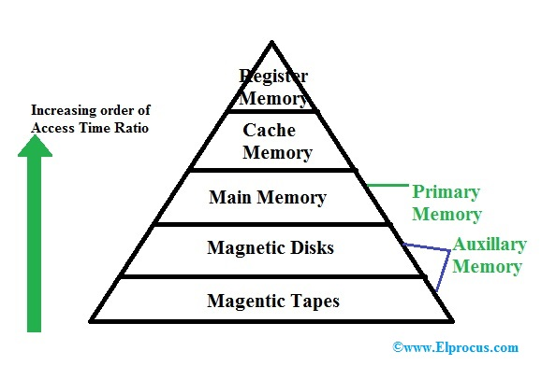

Slide 115
INTERNAL MEMORY
Internal memory (also known as main memory or prime memory), often referred to simply as memory, is the only one directly accessible to the CPU. The CPU continuously reads instructions stored there and executes them as required. Any data actively operated on is also stored there in uniform manner.
It typically refers to main memory (RAM), but may also refer to ROM and flash memory. In either case, internal memory generally refers to chips rather than disks or tapes.

Slide 116
EXTERNAL MEMORY
Secondary storage (also known as external memory or auxiliary storage), differs from primary storage in that it is not directly accessible by the CPU. The computer usually uses its input/output channels to access secondary storage and transfer the desired data to primary storage. Secondary storage is non-volatile (retaining data when power is shut off). Modern computer systems typically have two orders of magnitude more secondary storage than primary storage because secondary storage is less expensive.
It typically refers to portable flash drive, hard drive or a memory card that is used in a device such as a camera.

Slide 117
TYPES OF PRIMARY MEMORY
ROM (Read only memory)
PROM
EPROM
EEPR OM
RAM (Random access memory)
SRAM
DRAM

Slide 118
ROM
Read-only memory, or ROM, is a type of computer storage containing non-volatile, permanent data that, normally, can only be read, not written to. ROM contains the programming that allows a computer to start up or regenerate each time it is turned on. ROM also performs large input/output (I/O) tasks and protects programs or software instructions. Once data is written on a ROM chip, it cannot be removed.It has 3 types –
PROM
EPROM
EEPROM

Slide 119
PROM
It stands for programmable read-only memory, a memory chip on which data can be written only once. Once a program has been written onto a PROM, it remains there forever. Unlike RAM, PROMs retain their contents when the computer is turned off.
The difference between a PROM and a ROM (read-only memory) is that a PROM is manufactured as blank memory, whereas a ROM is programmed during the manufacturing process. To write data onto a PROM chip, you need a special device called a PROM programmer or PROM burner. The process of programming a PROM is sometimes called burning the PROM.

Slide 120
EPROM
EPROM (erasable programmable read-only memory) is programmable read-only memory (programmable ROM) that can be erased and re-used. Erasure is caused by shining an intense ultraviolet light through a window that is designed into the memory chip. (Although ordinary room lighting does not contain enough ultraviolet light to cause erasure, bright sunlight can cause erasure).

Slide 121
EEPROM
EEPROM (electrically erasable programmable read-only memory) is user-modifiable read-only memory (ROM) that can be erased and reprogrammed (written to) repeatedly through the application of higher than normal electrical voltage. Unlike EPROM chips, EEPROMs do not need to be removed from the computer to be modified. However, an EEPROM chip has to be erased and reprogrammed in its entirety, not selectively. It also has a limited life - that is, the number of times it can be reprogrammed is limited to tens or hundreds of thousands of times. In an EEPROM that is frequently reprogrammed while the computer is in use, the life of the EEPROM can be an important design consideration.

Slide 122
RAM
RAM (Random Access Memory) is the hardware in a computing device where the operating system (OS), application programs and data in current use are kept so they can be quickly reached by the device's processor. RAM is the main memory in a computer, and it is much faster to read from and write to than other kinds of storage, such as a hard disk drive (HDD), solid-state drive (SSD) or optical drive.

Slide 123
DRAM
Stands for "Dynamic Random Access Memory." DRAM is a type of RAM that stores each bit of data on a separate capacitor. This is an efficient way to store data in memory, because it requires less physical space to store the same amount of data than if it was stored statically. Therefore, a DRAM chip can hold more data than an SRAM (static RAM) chip of the same size can. However, the capacitors in DRAM need to constantly be refreshed to keep their charge, so DRAM requires more power than SRAM.

Slide 124
SRAM
SRAM (static RAM) is random access memory (RAM) that retains data bits in its memory as long as power is being supplied. Unlike dynamic RAM (DRAM), which stores bits in cells consisting of a capacitor and a transistor, SRAM does not have to be periodically refreshed. Static RAM provides faster access to data and is more expensive than DRAM. SRAM is used for a computer's cache memory and as part of the random access memory digital-to-analog converter on a video card.

Slide 125
CACHE MEMORY ORGANIZATION
Cache Memory is a special very high-speed memory. It is used to speed up and synchronizing with high-speed CPU. Cache memory is costlier than main memory or disk memory but economical than CPU registers. Cache memory is an extremely fast memory type that acts as a buffer between RAM and the CPU. It holds frequently requested data and instructions so that they are immediately available to the CPU when needed.

Slide 126
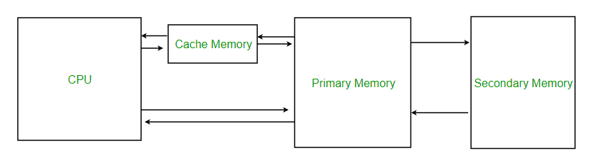

Slide 127
VIRTUAL MEMORY
Virtual Memory is a storage allocation scheme in which secondary memory can be addressed as though it were part of main memory. The addresses a program may use to reference memory are distinguished from the addresses the memory system uses to identify physical storage sites, and program generated addresses are translated automatically to the corresponding machine address. The size of virtual storage is limited by the addressing scheme of the computer system and amount of secondary memory is available not by the actual number of the main storage locations.

Slide 128
TYPES OF SECONDARY STORAGE
MAGNETIC DISKS.
MAGNETIC TAPES.
OPTICAL MEMORY.
DVD.

Slide 129
MAGNETIC DISKS
A magnetic disk is a storage device that uses a magnetization process to write, rewrite and access data. A magnetic disk primarily consists of a rotating magnetic surface and a mechanical arm that moves over it. The mechanical arm is used to read from and write to the disk. The data on a magnetic disk is read and written using a magnetization process. Data is organized on the disk in the form of tracks and sectors, where tracks are the circular divisions of the disk. Tracks are further divided into sectors that contain blocks of data. All read and write operations on the magnetic disk are performed on the sectors.

Slide 130
MAGNETIC TAPES
A magnetic tape drive is a storage device that makes use of magnetic tape as a medium for storage. It uses a long strip of narrow plastic film with tapes of thin magnetizable coating. Magnetic tape drives store data on magnetic tape using digital recording. The tapes are usually stored on cartridges or cassettes, but for drives that are used as data storage tape backups, the tape is often wound on reels. Magnetic tape is not the most dense data storage medium.

Slide 131
OPTICAL MEMORY
Optical storage is the storage of data on an optically readable medium. Data is recorded by making marks in a pattern that can be read back with the aid of light, usually a beam of laser light precisely focused on a spinning optical disc. An older example of optical storage that does not require the use of computers, is microform. There are other means of optically storing data and new methods are in development. An optical disc drive is a device in a computer that can read CD-ROMs or other optical discs, such as DVDs and Blue-ray discs. Optical storage differs from other data storage techniques that make use of other technologies such as magnetism, such as floppy disks and hard disks, or semiconductors, such as flash memory and RAM.

Slide 132
DVD
Stands for "Digital Versatile Disc." A DVD is a type of optical media used for storing digital data. It is the same size as a CD, but has a larger storage capacity. Some DVDs are formatted specifically for video playback, while others may contain different types of data, such as software programs and computer files. The original "DVD-Video" format was standardized in 1995 by consortium of electronics companies, including Sony, Panasonic, Toshiba, and Philips.

Slide 133
UNIT-5

Slide 134
Fetch and Execution Cycle
The fetch execute cycle is the basic operation (instruction) cycle of a computer (also known as the fetch decode execute cycle).
During the fetch execute cycle, the computer retrieves a program instruction from its memory. It then establishes and carries out the actions that are required for that instruction.
The cycle of fetching, decoding and executing an instruction is continuously repeated by the CPU while the computer is turned on.

Slide 135
Fetching and Executing steps :
The PC contains the address of the memory location that has the next instruction which has to be fetched.
This address is then copied from the PC to the MAR via the address bus.
The contents (instruction) at the memory location (address) contained in MAR are then copied into the MDR.
The contents (instruction) in the MDR is then copied and placed into the CIR.
The value in the PC is then incremented by 1 so that it now points to the next instruction which has to be fetched.
The instruction is finally decoded and then executed by sending out signals (via control bus) to the various components of the computer.
Repeat.

Slide 136
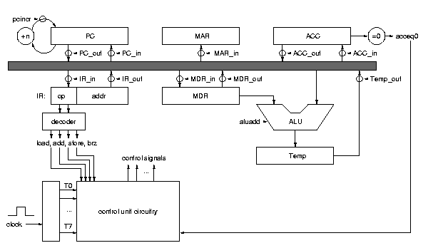
Process of execution of data/program

Slide 137
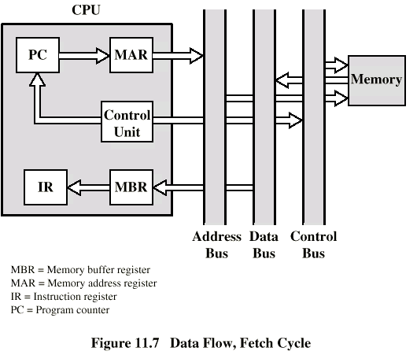
Data Flow in Fetch Cycle

Slide 138
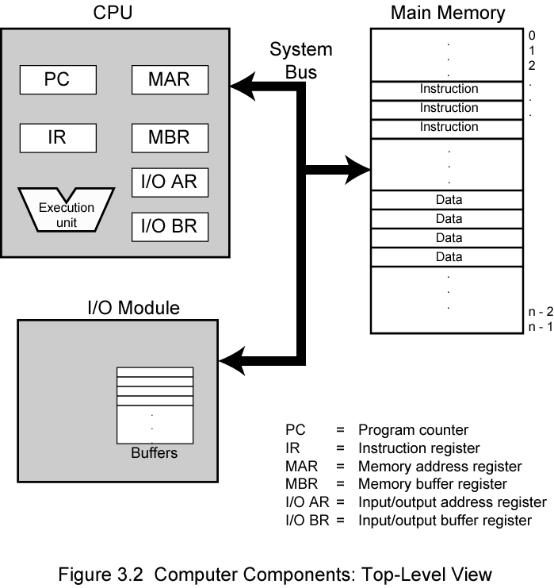
CONTROL REGISTERS
A control register is a processor register which changes or controls the general behavior of a CPU or other digital device. Common tasks performed by control registers include interrupt control, switching the addressing mode, paging control, and coprocessor control .

Slide 139
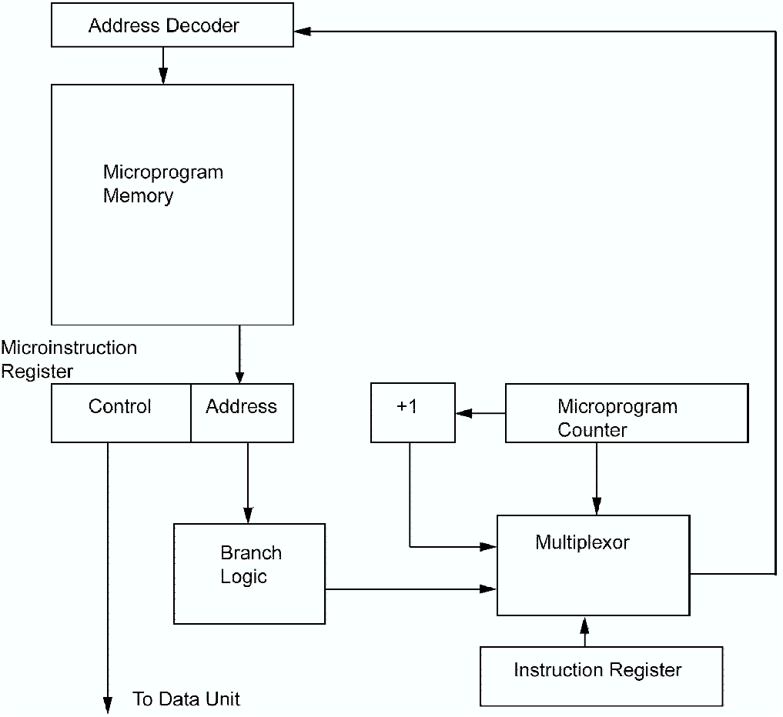
MICROPROGRAMMING
Microprogramming, Process of writing microcode for a microprocessor. Microcode is low-level code that defines how a microprocessor should function when it executes machine-language instructions. Typically, one machine-language instruction translates into several microcode instructions. On some computers, the microcode is stored in ROM and cannot be modified; on some larger computers, it is stored in EPROM and therefore can be replaced with newer versions

Slide 140
THANKS

